Slide 1
Colorectal Cancer and Ostomies
Jenny Cataldo RN, BSN, OCN
Oncology Nurse Navigator John Stoddard Cancer Center

Slide 2
Colorectal Cancer Treatment
Surgery
Radiation
Chemotherapy

Slide 6
Chemo Side Effects/Ostomies
Increased risk for infection
Nausea/Vomiting
Diarrhea (High risk for dehydration)
Constipation
Risk For bleeding
Neuropathy
Fatigue
Change in taste of food/decreased appetite
Mouth Sores

Slide 7
Colorectal Cancer Surgeries
Right Hemicolectomy
Left Hemicolectomy
Sigmoidectomy
Low Anterior Resection (temporary ileostomy)
Abdominal Perineal Resection (permanent colostomy)

Slide 8
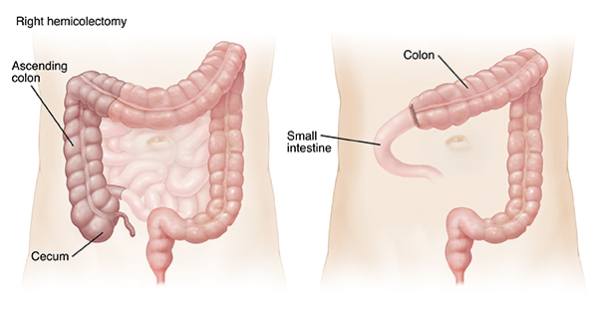
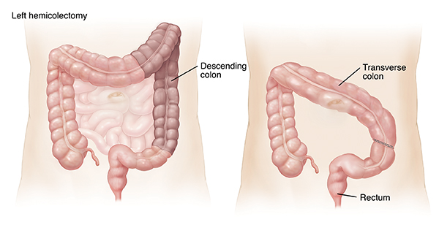
Right Left
Hemicolectomy Hemicolectomy

Slide 9
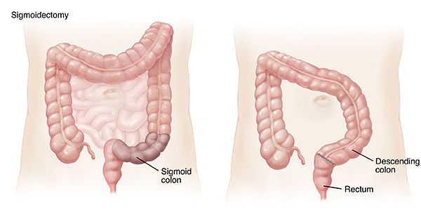
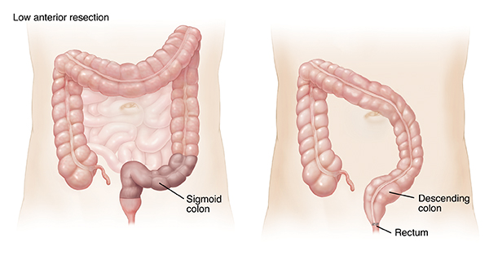
Sigmoidectomy Low Anterior
Resection

Slide 10
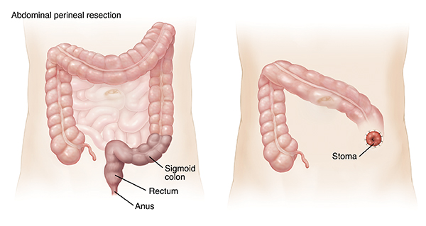
Abdominal Perineal Resection

Slide 11
Concerns After Surgery
Bowel Function: Your bowels take several weeks to settle down and may be unpredictable at first. Your bowel movement may be loose, or you may be constipated.
Abdominal Pain: It is not unusual to suffer gripping pains(colic) during the first week following removal of a portion of your bowel. This pain usually lasts for a few minutes but goes away between spasms. If you have severe pain lasting more than 1-2 hours or have a fever and feel generally unwell, you should contact you surgeon
Diarrhea: First step to improving your frequent or loose stools is to bulk up the stool with food by adding things like peanut butter, marshmallows, bread, and bananas to your diet. Second step is to add a fiber supplement. Psyllium is the most common type of fiber that is available at any drugstore. If this doesn’t work, you may try over the counter loperamide (Imodium). Call surgeon with any concerns.

Slide 12
Concerns After Surgery
Urinary Function: After bowel surgery you may get a feeling that your bladder is not emptying fully. This usually resolves with time. However, if there is any concern call your surgeon.
Post Surgery Diet: Consuming enough calories, protein, vitamins and minerals is necessary to support healing. Sometimes appetite is low after surgery. In this case frequent small meals throughout the day may help. Try to eat a balanced diet which includes food that is soft, moist and easy to chew and swallow, canned or soft-cooked fruits and vegetables. Plenty of soft breads, rice, pasta potatoes and other starchy foods (low fiber varieties may be tolerated better initially). High protein foods and beverages, such as meats, eggs, milk, cottage cheese, or a supplemental nutrition drink like Boost or Ensure. Drink Plenty of fluids at least 8-10 cups per day.
Additional Dietary Tips: Avoid drinking a lot of caffeine, since this may dehydrate you. Avoid greasy and highly seasoned or spicy foods. Avoid carbonated beverages in the fist couple of weeks. Avoid raw fruits and vegetable
Walking is encouraged after surgery. You may climb stairs. Don’t lift over 10 pounds or play contact sports for the first month after surgery

Slide 13
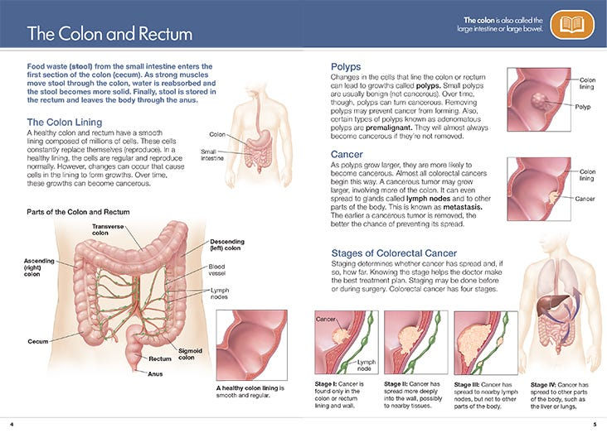

Slide 14
Living with an Ostomy
Some treatments for cancer can result in the need for an ostomy.
This can be temporary or permanent.
  A permanent ostomy is a life-long change that can come with significant psychological distress, skin problems around the stoma and relationship concerns. It can take time to adjust to life with an ostomy. Many people feel isolated after ostomy surgery and unsure of how they will enjoy life again.
  It is important to remember that many people live long, healthy and fulfilling lives with an ostomy.
  Connecting with a support group or another patient who has been through the same thing can help be a reliable source of information and support.

Slide 15
Ostomy
Colostomy: The surgically created opening of the colon (large intestine) which results in a stoma. A colostomy is created when a portion of the colon or the rectum is removed, and the remaining colon is brought to the abdominal wall. It may further be defined by the portion of the colon involved and/or its permanence.
Temporary Ileostomy: Allows the lower portion of the colon to rest or heal. It may have one or two openings.
Permanent Colostomy: Usually involves the loss of part of the colon, most commonly the rectum. The end of the remaining portion of the colon is brought out to the abdominal wall to form the stoma.
Ileostomy: A surgically created opening in the small intestine, usually at the end of the ileum. The intestine is brought through the abdominal wall to form a stoma. Ileostomies may be temporary or permanent and may involve removal of all or part of the entire colon.

Slide 16
Common Issues with Ostomies while Undergoing Cancer Treatments
Diarrhea
Constipation
Dehydration
Nutrition
Skin irritation/breakdown
Leaking
Blockages or bowel obstructions
Bleeding
Peristomal hernia
Intimacy and Sexuality with an ostomy

Slide 17
Survivorship Issues
Removal of part of bowel
Medication side effects
Radiation side effects
Sexual Health
Psychosocial

Slide 18
Removal of a Section of Bowel
People have 5 to 6 feet of large bowel. If a section is removed, the remaining bowel can often have normal bowel function, but this is not always the case. Survivors are at risk for changes in how your bowel functions. Radiation therapy to the abdomen and treatment with chemotherapy agents that cause bowel issues (vincristine, vinorelbine, or vinblastine) can increase the risk of side effects.
After surgery, many survivors report
Needing to move their bowels frequently and/or urgently.
Having loose stools.
Gas / Bloating.
Being intolerant of certain foods.
These problems can have a big effect on your quality of life, but some changes may help. Start by keeping a food diary. Record what and when you eat, what side effects you have, and when they occur in relation to meals. This may give you a clear idea of what foods you need to avoid.
Working with a registered dietitian can be helpful. They can help you to meal plan and teach you about dietary needs and changes after surgery. A dietitian can make recommendations regarding how much protein, complex carbohydrates, and fats you should eat each day.
In addition, abdominal surgeries can put you at risk for bowel obstructions (due to scarring), hernia (due to cutting the abdominal muscle), and changes in bowel patterns. Radiation therapy to the abdomen and pelvis can increase the risk of these complications.

Slide 19
Risks Related to Medications
Neuropathy
Neuropathy can be a long-lasting side effect that can require physical therapy, changes in your daily life for safety, and managing pain with medication.
Skin Changes
Care for your skin with mild soaps and hydrating lotions.
Protect your skin from sun damage.
neuropathy can be a long-lasting side effect that can require physical therapy, changes in your daily life for safety, and managing pain with medication.
Chemo Brain
There is no proven treatment for chemo brain, but cognitive rehabilitation/brain games, avoiding becoming fatigued, regular exercise, and a healthy diet can be helpful.
  Create reminders by making lists, using to-do apps or alarms on a phone to help you stay on track.
  If you believe you are experiencing chemo brain, you should consult your care provider to rule out other health issues including thyroid problems, depression, and anxiety.

Slide 20
Side Effects of Radiation
Skin: The area of skin that was affected by radiation may be more sensitive. The skin will likely always be drier. Care for your skin using mild soaps and moisturizers. Use sunscreen daily to prevent sunburns.
Contact your provider if you have any changes to your skin.
Bowel: The bowel is quite sensitive to the effects of radiation. The late effects that may occur after radiation to the rectum, colon, or small bowel include:
Scarring and strictures
Ulceration and bleeding
Chronic diarrhea
Fistula formation
Bladder: Any bladder or urinary symptoms such as frequency and urgency with urinating, blood in the urine or not being able to hold or expel your urine, should be evaluated by your care provider.

Slide 21
Sexual Health
Can I have a normal sex life with an ostomy?
  Sexual concerns and worries about changes in physical appearance are common
    These may improve as you adjust and get used to your ostomy and pouch
  Choosing sexual positions that are comfortable and have minimal pressure on the bag can prevent problems or leakage.
    Pouch covers or sashes can be used to cover the pouch during intimate moments.
  Communicating with your partner is important - especially when you are resuming intimate relationships.
  Seek counseling when needed

Slide 22
Pelvic Radiation and Sexual Health
Key Takeaways: Male
You may have sexual health issues after radiation to the pelvis including infertility, low testosterone levels, low sperm count, and sexual dysfunction. You may have tests done to monitor for these issues. You should speak to your provider openly about any issues you are having.
A urologist can help if erectile dysfunction is an issue you are experiencing.
If you have swelling of or around your genitals or groin you should contact your provider.

Slide 23
Pelvic Radiation and Sexual Health
Key Takeaways: Female
Any symptoms such as pain during intercourse, difficulty with tampon insertion, vaginal burning or itching, pain or difficulty urinating, should be evaluated by your care provider.
If your vaginal area is dry, painful, or tender, products such as vaginal moisturizers, lubricants, and vitamin E, may be helpful.
You will be taught how to use a vaginal dilator. It is important that you continue to use the dilator per your provider’s instructions. This is to prevent shrinking of the vagina or scar tissue development.
Physical or lymphedema therapy can be used to treat swelling of the genitals or legs. Report any swelling to your provider.
If you want to become pregnant, you should speak with a high-risk pregnancy specialist.
You should be evaluated by an endocrinologist for hormonal abnormalities and / or premature menopause.

Slide 24
Key Takeaways for Radiation Side Effects
Key Takeaways:
New or worsening belly pain, bloating, or swelling with nausea/vomiting or constipation can be symptoms of a bowel obstruction, which can be a medical emergency. Call your provider right away if you are having these symptoms.
If you are having bleeding from your rectum or are having dark-colored stools you should call your provider.
Abnormally passing urine or stool needs to be evaluated by your provider. Call your provider right away if you experience this issue.
Speak with your provider about options for anti-diarrheal medications if you are having chronic diarrhea.
A registered dietitian can work with you to ensure you are getting enough nutrition to prevent weight loss.
Talk to your provider about when you should have colon cancer screening.

Slide 25
Sexual Health Support
Mid-Iowa Fertility Clinic
One Iowa
Ostomy Support Group
Ostomysecrets: Ostomy underwear and garments 1-877-613-6246 https://www.ostomysecrets.com/
Colorectal Cancer Support Group
Mental Health Counselors
Pelvic Floor Specialist; Oncology Rehab; The Iowa Clinic, Des Moines University
Urology
American Cancer Society: Sex and the Man with Cancer; Sex and the Woman with cancer
All of Me https://allofmeiowa.org/

Slide 26
Coping with Practical Concerns after Cancer
Learn about your rights and your employer's responsibilities under the law. You may want to talk with human resources professionals at your job about things like returning to work, FMLA, and reasonable accommodations.
OncoLink’s Section on legal, insurance, employment, and financial concerns provides great information about these issues.
Cancer and Careers is a resource for all things work-related, from time of diagnosis well into survivorship.
The National Coalition for Cancer Survivorship and the American Cancer Society websites have financial and insurance information for survivors.
The Cancer Legal Resource Center and Triage Cancer provide information on cancer-related legal issues, including insurance coverage, employment and time off, and healthcare and government benefits.
https://oncolife.oncolink.org/

Slide 27
Coping with Emotional Concerns after Cancer
It is normal to feel depressed, anxious, or worried when colorectal cancer is a part of your life. Some people are affected more than others. But everyone can benefit from help and support from other people, whether friends and family, religious groups, support groups, professional counselors, or others.
Colorectal Cancer Alliance https://www.ccalliance.org/colorectal-cancer-information/resources-for-patients
American Cancer Society https://www.cancer.org/
Above and Beyond Cancer https://aboveandbeyondcancer.org/
John Stoddard Cancer Center
Colorectal Cancer Support group Call 515-241-4344
Caregiver Support Group Call 515-241-4234
Ostomy Support Group email HeartofIowaOstomyGroup@gmail.com

Slide 28
Can I lower my Risk of Colorectal Cancer Progressing or Coming Back?
Getting to and staying at a healthy weight:
Being active: A good deal of research suggests that people who get regular physical activity after treatment have a lower risk of colorectal cancer recurrence and a lower risk of dying from colorectal cancer. Physical activity has also been linked to improvements in quality of life, physical functioning, and fewer fatigue symptoms.
Eating healthy: Some studies have suggested that colorectal cancer survivors who eat diets high in vegetables, fruits, whole grains, chicken, and fish might live longer than those who eat diets with more refined sugars, fats, and red or processed meats.
Dietary supplements: So far, no dietary supplements have been shown to clearly help lower the risk of colorectal cancer progressing or coming back. This doesn’t mean that none will help, but it’s important to know that none have been proven to do so.
Vitamin D:Some research has suggested that colorectal cancer survivors with higher levels of vitamin D in their blood might have better outcomes than those with lower levels. Other research has suggested that people with colorectal cancer who have low vitamin D levels may have a worse survival than those with normal levels, but more studies are needed. But it’s not yet clear if taking vitamin D supplements can affect outcomes.
Calcium: Some research has suggested that calcium supplements can lower the risk of colorectal polyps in people who have previously had polyps. Other research has suggested that people with early-stage colorectal cancer who take in a higher level of milk and calcium may have a lower the risk of dying. But it’s not clear if calcium supplements can lower the risk of colorectal cancer coming back.
Aspirin: Many studies have found that people who regularly take aspirin have a lower risk of colorectal cancer and polyps. Some evidence suggests that starting aspirin after someone is diagnosed with colorectal cancer might lower the risk of the cancer coming back and also the risk of dying from it. It is not clear, though ,if this benefit is seen in all people with colorectal cancer.
Alcohol: Drinking alcohol has been linked with an increased risk of getting colorectal cancer, especially in men. But whether alcohol affects the risk of colorectal cancer recurrence is not as clear. It is best not to drink alcohol. For people who do drink alcohol, they should have no more than 1 drink a day for women and no more than 2 drinks a day for men. This can help lower their risk of getting certain types of cancer (including colorectal cancer).
Quitting smoking: Research has shown that colorectal cancer survivors who smoke are more likely to die from their cancer (as well as from other causes). Aside from any effects on colorectal cancer risk, quitting smoking can clearly have many other health benefits.
https://www.cancer.org/

Slide 29
Ostomy Resources
UnityPoint Wound Healing Center 515-241-4325 Please call for an appointment if difficulty with leaking, skin irritation, or if you need a change in the type of ostomy appliance.
Ostomy Support Group: Virtual and in person option. Email HeartofIowaOstomyGroup@gmail.com to be added to email distribution list
United Ostomy Association of America www.ostomy.org
https://www.ostomy.org/diet-nutrition/ For evidenced based information regarding your ostomy including diet
Quick Guide for Troubleshooting www.psag.wocn.org
Ostomy Secrets https://www.ostomysecrets.com/

Slide 30
Sources used for this Presentation
https://oncolife.oncolink.org/
https://www.cancer.org/
https://www.ccalliance.org/colorectal-cancer-information/resources-for-patients

