Slide 1
Ostomy Support Group
May 3rd 2023

Slide 2
Ostomy Complications
First we will look at those seen more
immediately post-op
Then look at complications that can
happen later

Slide 3
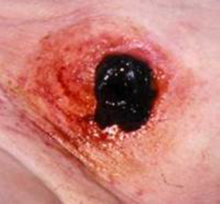
Necrotic Stoma

Slide 4
Blood flow to the stoma is impaired
Most likely to occur in first 5 days after surgery
May be all the stoma or partial stoma
May result in retracted stoma or stomal stenosis
Needs surgical intervention if below fascia level

Slide 5
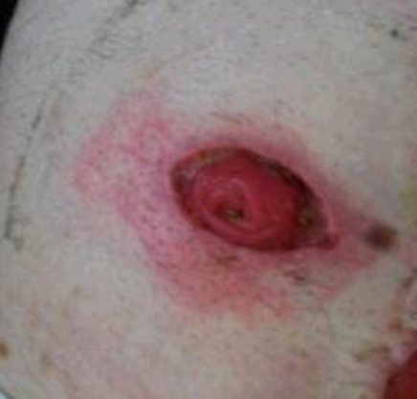
Mucocutaneous Junction Separation

Slide 6
Occurs the first few weeks after surgery
Usually occurs when there is compromised wound healing: diabetes, chemotherapy, poor nutrition, corticosteroid use.
Can be deep or shallow
Usually will heal on its own. Sometimes have to pack. Again want to make sure it does not go below the fascia

Slide 7
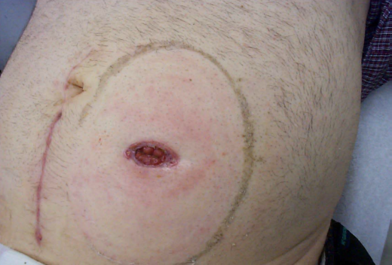
Retracted Stoma

Slide 8
More prone in ileostomies with Crohns disease
May be due to inadequate length of bowel to pull out or due to stoma necrosis and loss of some of the stoma. Usually see fairly soon after surgery
Leakage problems sometimes

Slide 9
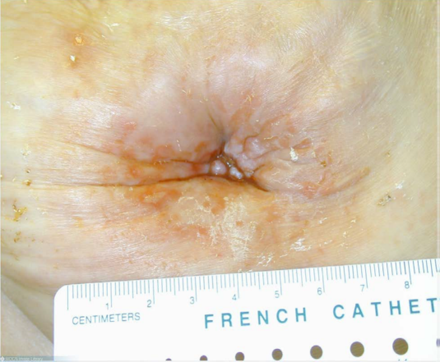
Stenosis of Stoma

Slide 10
Can happen early or later on
Result of retracted stoma with mucocutaneous separation or necrotic stoma, or scar tissue
Stricture can become an obstruction and surgery is needed.
Can be difficult to pouch

Slide 11
Common Ostomy Complications
These are some more common things that we see more frequently and can happen anytime.

Slide 12
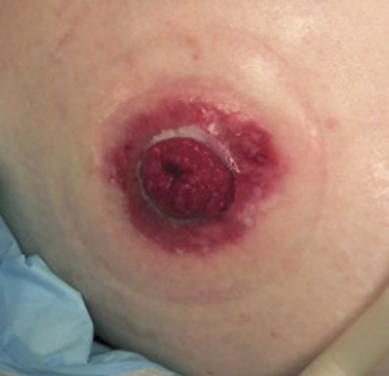
Irritation of skin around stoma

Slide 13
This is usually from cutting the opening too large in your flange or from leakage
It can also be due to an allergy from the ring or paste.
Treat with powder and skin prep and making opening smaller or eliminating the paste or ring. May have to change to a different brand if allergic

Slide 14
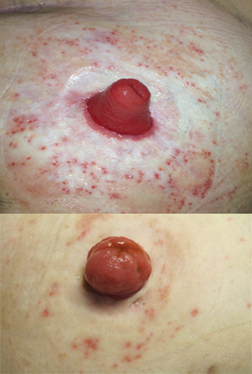
Folliculitis

Slide 15
Caused from pulling on hair follicles with pouch removal and areas become irritated or infected
This can be prevented by keeping the hair shaved and always gently removing your pouch
Treated with crusting stoma powder and skin prep. May need some antibacterial powder if infected

Slide 16
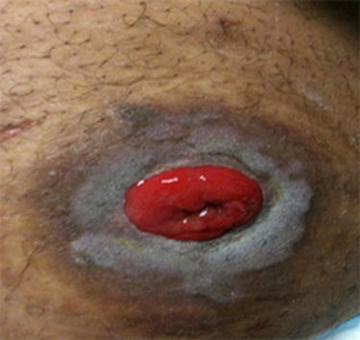
Maceration around the stoma
Usually happens with Urostomies

Slide 17
Caused from urine being on the skin either from leaking or making opening too large.
Sometimes urostomy skin can just get discolored so need to make sure it is really moist.
Smaller opening or fix leaking, and treat with powder and skin prep (crusting)

Slide 18
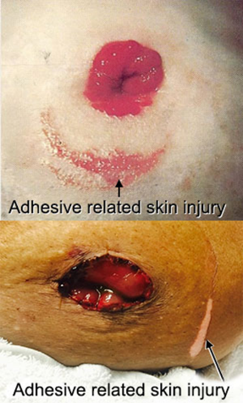
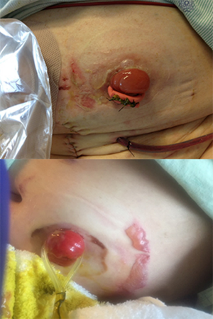
Skin Damage from Tape

Slide 19
Be careful how you pull off your flange. Push and Pull
Treat with powder and skin prep. If weeping too much may have to cover with small dressing.

Slide 20
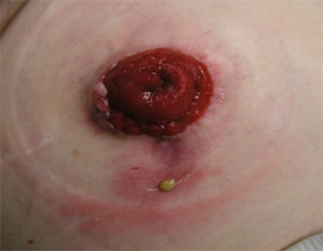
Pus in the wound
This may indicate infection and may need an antibiotic
May need dressing over draining area

Slide 21
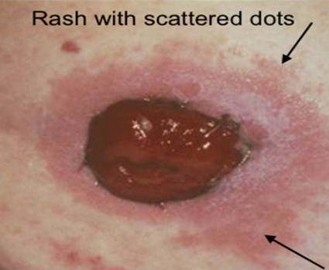
Fungal infections

Slide 22
Happens a lot in the summer due to sweating.
Can be itchy and weep some
Treat with antifungal powder and skin prep (crusting)

Slide 23
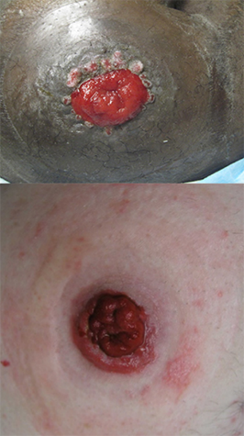
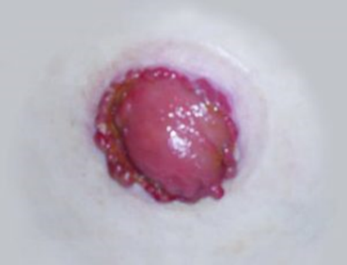
Hypergranulation or Granulomas

Slide 24
Extended inflammatory response
The wound heals before the stoma matures. Usually occurs within 6 weeks of surgery
Can also occur later due to moisture and friction from appliance
Treat with silver nitrate sticks( burning off of tissue)

Slide 25
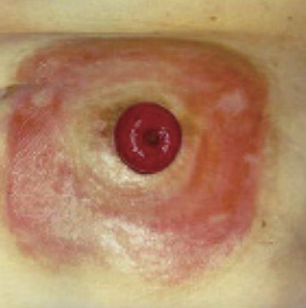
Allergy to device or excessive leaking

Slide 26
Can be an allergy to device if the redness goes all the way around
If having excessive leaking and stool is getting all over back of flange can also cause moisture damage like this
If allergic may have to change to different brand, no tape, or otherwise protect skin with skin prep or protective sheet.

Slide 27
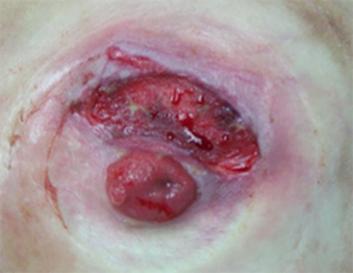
Deep Wound

Slide 28
Can be from pressure from a convex appliance
Can be some other disease process going on such as pyoderma or Crohns
Treat with a dressing under the flange and may have to change the appliance more frequently

Slide 29
Later complications
These happen less frequently

Slide 30
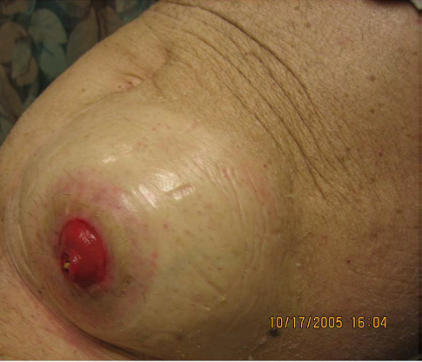
Stomal Hernia

Slide 31
It can affect up to 50% of patients one year after surgery
Can reduce in size when patient lays down
May make pouching difficult but otherwise asymptomatic
May benefit from hernia belt.
Have to have emergency surgery if become strangulated. Reoccurs frequently after repaired

Slide 32
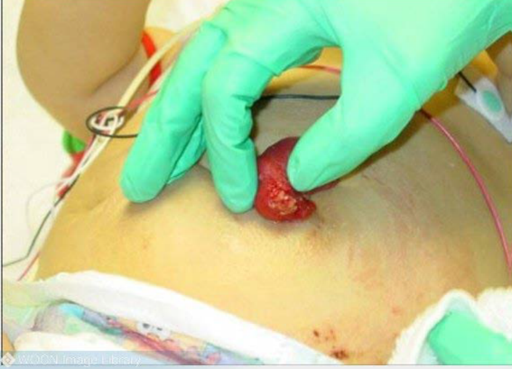
Stomal Laceration

Slide 33
Usually occurs from flange rubbing too much on stoma or from trauma ( razor, etc)
Excessive bleeding. Hold pressure. May have to suture or use silver nitrate to stop bleeding.
Cut opening a little larger if possible.

Slide 34
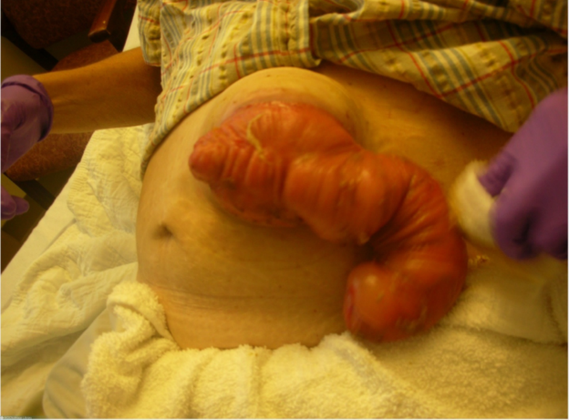
Prolapsed Stoma

Slide 35
Length of bowel protrudes through opening due to lack of fascial or muscle support
Can vary in length and can go in and out sometimes
Difficulty pouching sometimes due to size
Surgery if becomes obstructed

